Slide 1
Pathology of Gastric diseases
Prof. Janaki Hewavisenthi
Department of Pathology
Faculty of Medicine

Slide 2
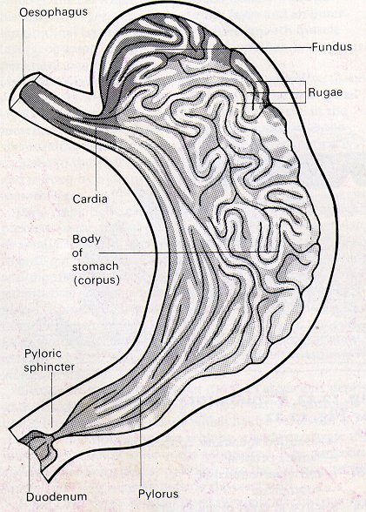
Normal Anatomy

Slide 3
STOMACH - Normal Histology
Gastric Mucosa
Foveolar region - Surface epithelium + gastric pits lined by mucous secreting cells.
Glandular area - Glands opening into the base of the gastric pits.
Muscularis mucosa
Submucosa
Muscularis propria - 3 layers.
Serosa - Mesothelial layer.

Slide 4
Normal Histology contd..
Gastric Glands - Mucous secreting cells, Parietal cells (HCL), Chief cells (Pepsin ).
Parietal cells –
    Cells with eosinophilic cytoplasm
    In the upper portion of the tubular gland.
Chief cells –
    Cells with basophilic cytoplasm,
    Pyramid shaped cells
    In the base of the glands.

Slide 5
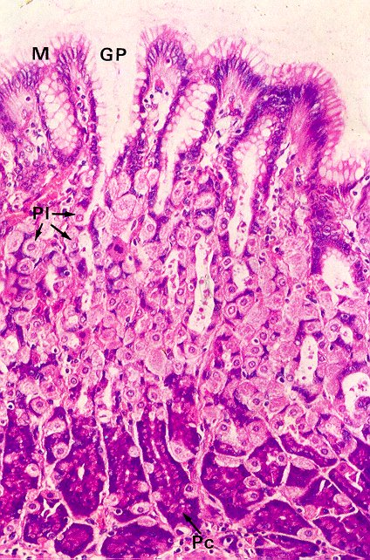

Slide 6
Anatomical variations
CARDIA –
  1 cm in length
  Small irregular branched glands secreting mucin.
  Foveolar region occupies 50% of the mucosa.
BODY & FUNDUS –
  Occupies most of the stomach.
  Foveolar region only 25 % of the mucosa.
  Long tubular glands (Parietal & Chief cells).
ANTRUM –
  Immediately proximal to the pylorus.
  Foveolar region occupies most of the mucosa.
  Less prominent racemose glands (Parietal & Neuroendocrine cells)

Slide 7
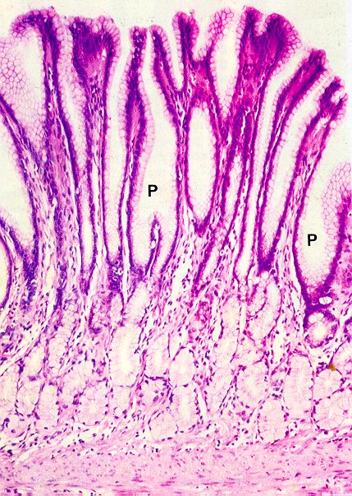

Slide 8
Lecture Outline
Gastritis (Acute and chronic)
Gastric ulcers / Peptic ulcers
Vascular abnormalities of the stomach
Polyps of the stomach
Gastric carcinoma and other tumors

Slide 9
Manifestations of Gastric diseases - Endoscopic appearances
  Diffuse involvement –
    Acute gastritis – erosions, oedema and hyperaemia
    Chronic gastritis – Erythema erosions, granularity and nodularity
    Antral predominant
    Corporal predominant
  Rugal hypertrophy / thickening of the wall
  Ulcers
  Vascular abnormalities
  Polyps

Slide 10
Manifestations of Gastric disease
Abdominal pain – Epigastric
Nausea
Vomiting
Dyspepsia
Weight loss
Anaemia
Upper GI bleeding.

Slide 11
Gastritis
Other types
Acute gastritis
Chronic gastritis
Diffuse eosinophilic Lymphocytic follicular Collagenous Hypertrophic Granulomatous
Type C / Reactive
Type A and B
or
According to
Sydney classification

Slide 12
Acute gastritis
Clinical features :
    Nausea, Vomiting, Epigastric pain and haematemesis.
Causes
    Asprin, NSAIDs, Steroids, potassium chloride, Iron pills
    Alcohol
    Chemotherapy, Radiation
    Uraemia
    Systemic infections (Salmonella, Staph)
    Stress and major trauma - (Burns-Curling ulcer, Head injury– Cushing ulcers)

Slide 13
Acute gastritis
Pathology -
  Mild - L.P contains few polymorphs
  Moderate - Oedema Hyperamia in inflammation
  Severe - Sloughing of mucosa (referred to as Acute erosive gastritis / Haemorrhagic gastritis)

Slide 14
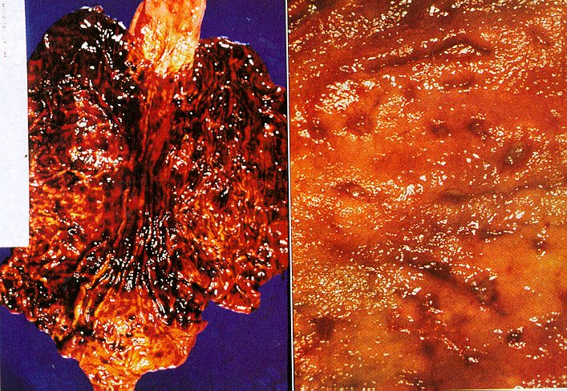

Slide 15
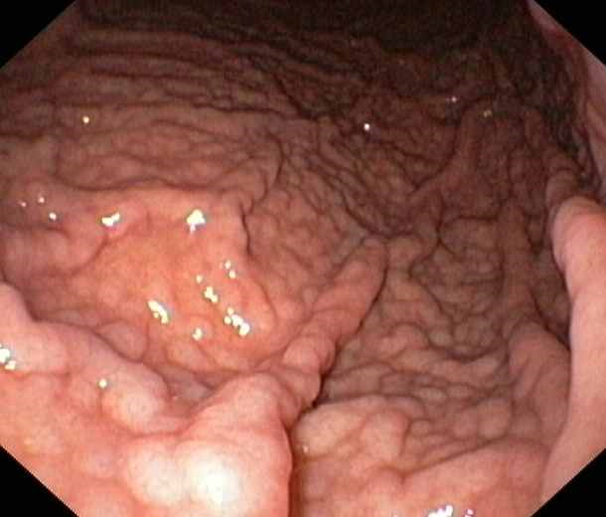
Chronic gastritis

Slide 16
Chronic Gastritis
Chronic superficial – Inflammation limited to the foveolar region.
Chronic Atrophic - Inflammation more extensive with glandular atrophy.
Gastric Atrophy - No inflammation
SYDNEY SYSTEM –
    Topography (Antral / body type mucosa)
    Inflammation (Acute and chronic ) ) Graded as mild
    Glandular atrophy ) moderate and
    Intestinal metaplasia ) severe
    Special types – Previously discussed
    Helicobacter pylori (density graded)

Slide 17
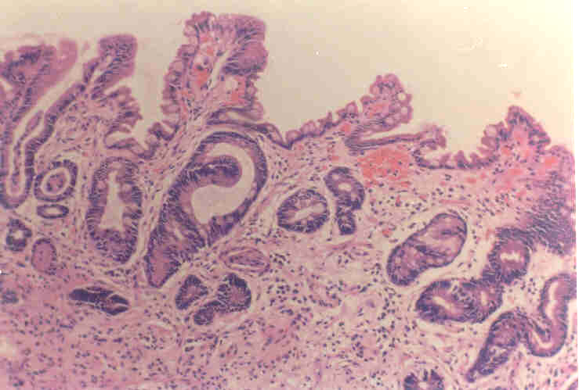
Intestinal metaplasia and glandular atrophy

Slide 18
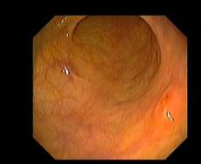
Atrophic gastritis – Glandular atrophy

Slide 19
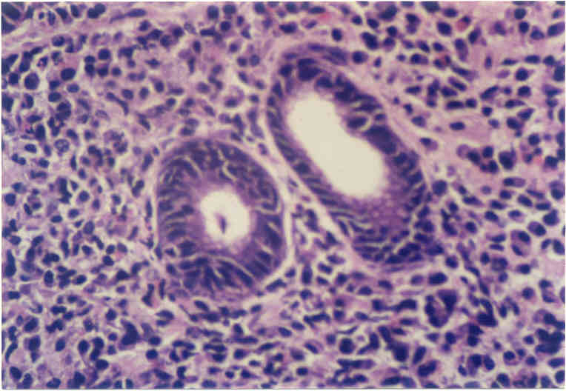
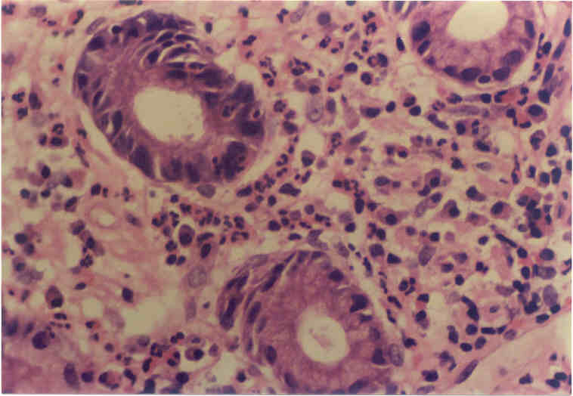
Inflammation
Chronic inflammation (severe)
Activity / Acute inflammation
(Moderate)

Slide 20
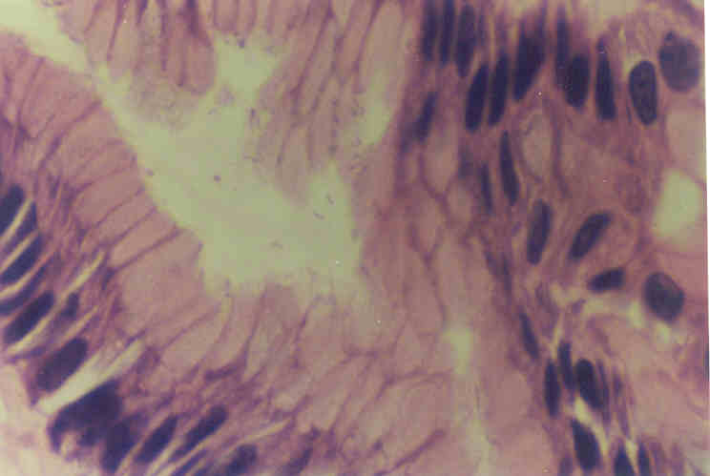
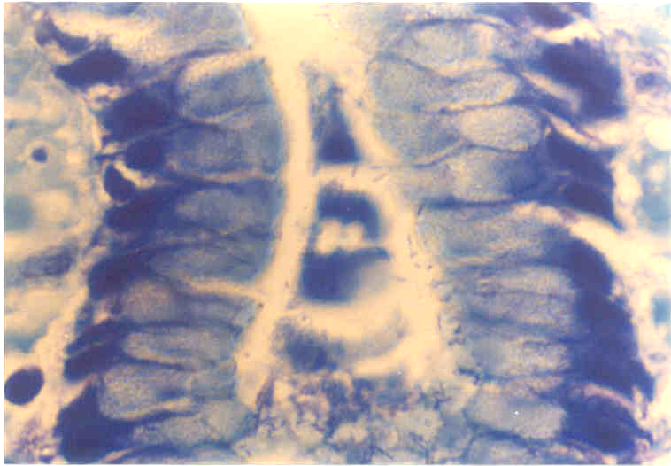
Helicobacter pylori

Slide 21
Chronic Gastritis.
Type A Immune/ Fundal
Involves body / Fundal mucosa.
Circulating AB’s
Hypo/ Achlorhydria
Hypergastrinaemia.
10% Develop pernicious Anaemia.
Ass: with Autoimmune disease.
Type B Non immune / Antral
Commoner in the antrum.
)
)
) (-)VE.
)
)
)
)

Slide 22
Type B Gastritis
Hyper secretory type
Secrete excess acid
Thus low PH - Duodenal ulcer
Type AB - Enviromental type
Patchy involvement of fundal
mucosa
Partial parietal loss
No hypchlorhydira
Gastrin Levels N/mildly decreased
?? Helicobacter pylori.

Slide 23
Helicobacter pylori
Antral Type B Gastritis.
Duodenal ulcer & Gastric Ulcer.
Non - ulcer Dyspepesia.
Maltomas / Lymphomas.
20 % of the normal population.

Slide 24
Helicobacter pylori
Microscopy
- Organisms along the luminal surface and does not penetrate the mucosa.
‘N’ limited to the superficial LP. Absent from foci of intestinal metaplasia
Acute and chronic inflammation
Other features caused
Glandular atrophy
Intestinal metaplasia

Slide 25
Helicobacter pylori

Slide 26
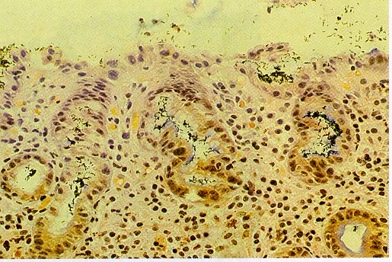

Slide 27
Type C gastritis / Reactive gastritis
Associated with :
  Biliary reflux
  Drugs
  Alcohol
Histological features
  Foveolar hyperplasia with a cork screw pattern
  Oedema of the lamina propria
  Vascular ectasia within the lamina propria
  Relative lack of inflammation within the lamina propria

Slide 28
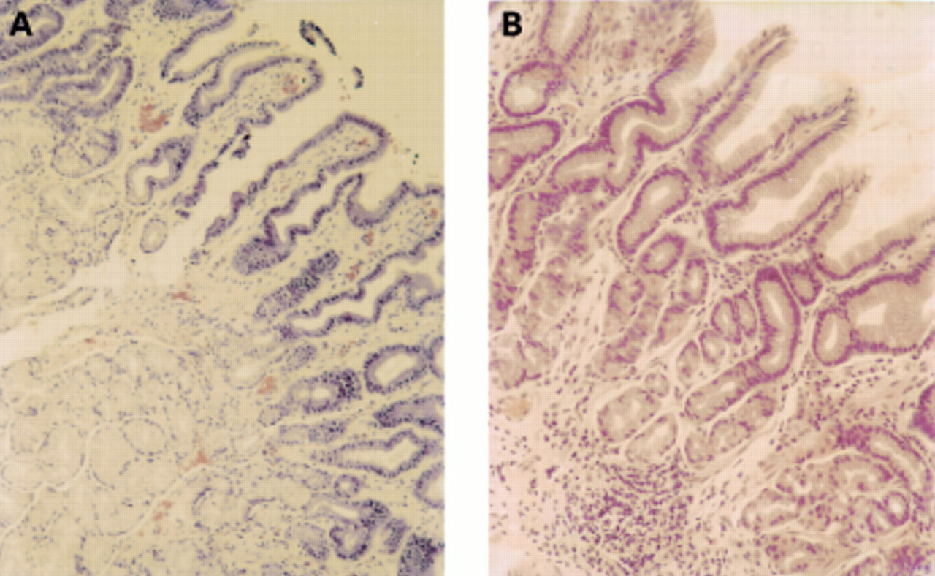
Type C gastritis – Reactive gastropathy

Slide 29
Other types of Gastritis
Diffuse Eosinophilic gastritis
Granulomatous gastritis
  Crohn disease
  Sarcoidosis
  Foreign body granuloma – Suture mucin Ba
  Tumour associated granuloma
  Infections – TB Whipple, Sarcoidosis, Leprosy, Syphilis Whipples and H pylori.
  Vasculitis – Churg Strauss
Collagneous gastritis
Lymphocytic gastritis
Follicular gastritis

Slide 30
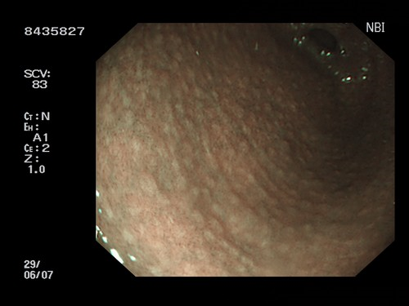
Varioliform Gastritis (Lymphocytic gastritis)

Slide 31
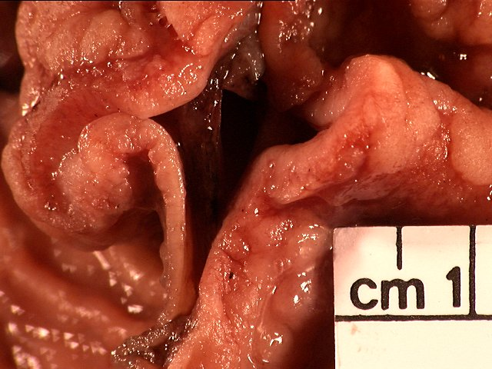
Rugal hypertrophy – Hyperplastic gastropathy

Slide 32
Hyperplastic gastropathy
Menetriers disease
  Involves the gastric body
  Marked foveolar hyperplasia with elongation and cystic dilatation of the foveolar epithelium.
  Protein loss marked
Zollinger Ellison Syndrome
  Hyperplasia of the parietal and chief cells.
  No foveolar hyperplasia and protein loss.
  Associated with multiple gastric ulcers
Hyperplastic hypersecretory gastropathy
  Similar to above but gastrin levels are normal
Chronic gastritis of H pylori and CMV
Rarely – Lymphomas, Diffuse adenocarcinoma, Gastric polyposis (Cronckhite Canada Syndrome)

Slide 33
ULCERS
Erosions
  Very superficial and the lesion is confined to the muscularis mucosae.
Acute ulcer
  Penetrates the muscularis mucosae but not the muscularis propria.
  Aetiology -
  Shock,
  Burns (Curlings’),
  Head injury ((Cushings)
  Asprin Caffein and Drugs.

Slide 34
Ulcers continued ……
Chronic peptic ulcer
  Mainly in the pyloric antrum, lesser curvature and 1st part of the duodenum
  Larger ( 1-5cm)
  Generally single
  Flat margins
  Associated closely with chronic gastritis.
Gastric carcinoma / Malignant ulcer
  Margins are raised

Slide 35
Morphology of Acute Ulcer
Multiple.
Scattered throughout the stomach.
Circular and small , <1.0cm in diamter.
Base stained brown (blood), not indurated,
Margins - Hyperaemia.
Rugal pattern not affected.
Healing complete with reepithelialization. No scarring

Slide 36
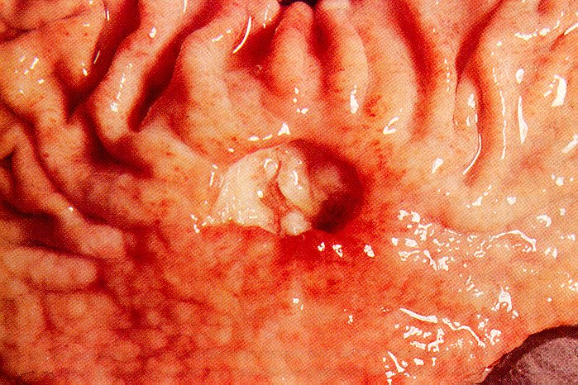

Slide 37
Peptic Ulcer
Definition - Ulceration of the mucosa exposed to the aggressive action of gastric juices.
Distribution –
  Duodenum ( 1st Part)
  Stomach (Antrum)
  Barrett’s oesophagus
  Gastroenterostomy stoma.
  Duodenum, Stomach & Jejunum (Zollinger - Ellison Syndrome)
  Meckel’s Diverticulum - Ectopic gastric mucosa

Slide 38
Pathogenesis of Peptic Ulcer.
All ulcers arise because of an imbalance between Aggressive action of pepsin/acid secretion and the normal defense mechanisms.
  Duodenal - Increased Acid / Pepsin secretion with heightened response to normal stimuli
  Gastric ulcer - Breakdown of mucosal defense mechanisms
    Eg: low levels of PGE₂ levels caused by aspirin ibuprofen and cigarette smoking.

Slide 39
Clinical feature & Complications
Clinical features –
    Epigastric pain
    Haematemesis
    LOW.
Complications –
  1. Bleeding
  2. Perforation - Peritonitis.
  3. Penetration into the adjacent viscera.
  4. Obstruction due to oedema and scarring
    Eg: Hour glass stomach & Pyloric stenosis.
  5. Malignant transformation - GU.

Slide 40
Vascular lesions of the stomach
Portal hypertensive gastropathy (PHG)
Gastric antral vascular ectasia (water melon stomach) = GAVE
Dieulafoys lesion (Caliber persistent artery)
  Mucosal defect overlying artery of persistent large caliber in the mucosa

Slide 41
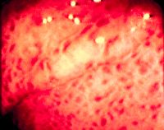
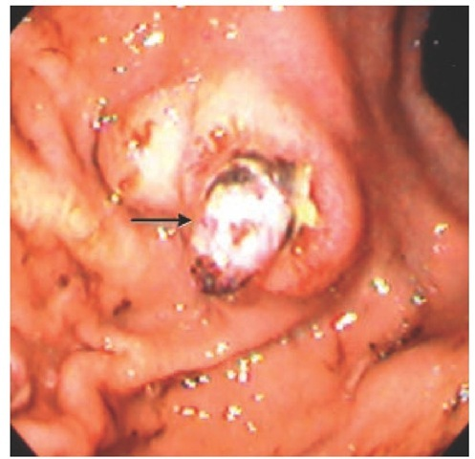
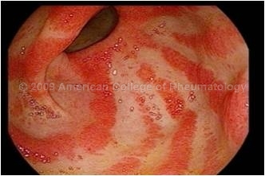

Slide 42
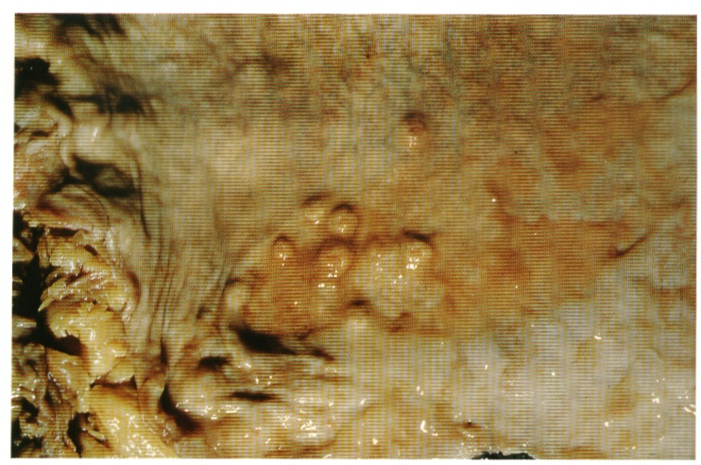
Gastric Polyps

Slide 43
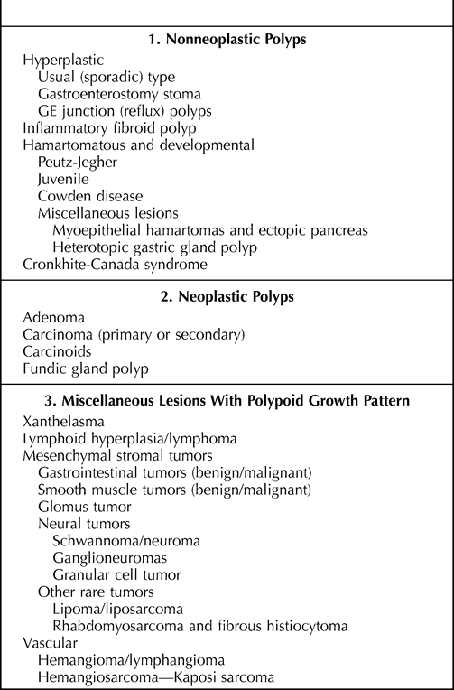

Slide 44
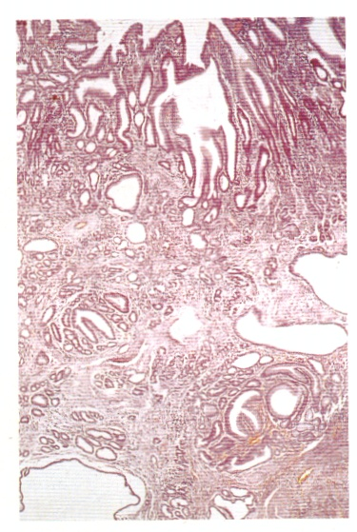
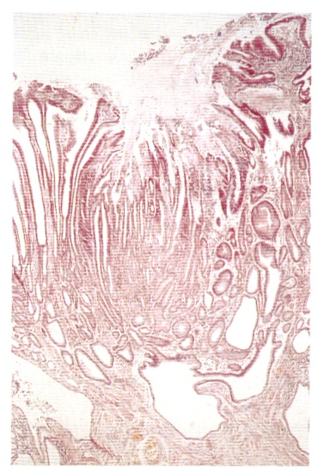
Hyperplastic polyp

Slide 45
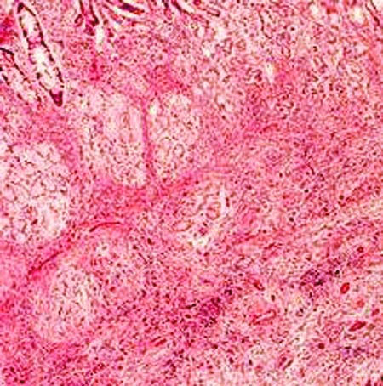
Inflammatory fibroid polyp

Slide 46
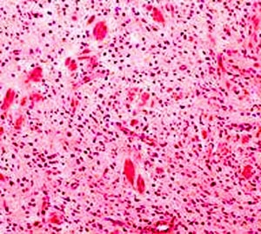
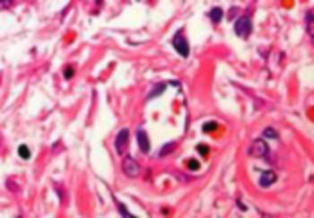

Slide 47
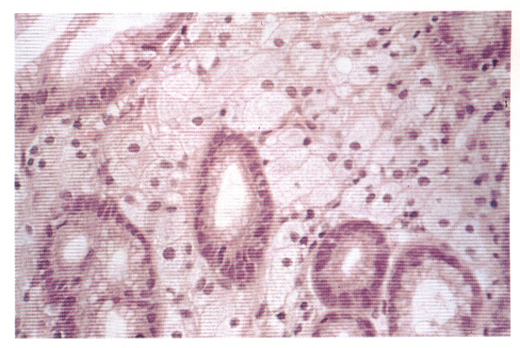
Xanthalesma

Slide 48
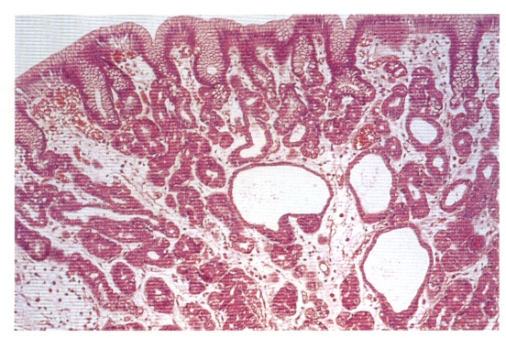
Fundic gland cyst / polyp

Slide 49
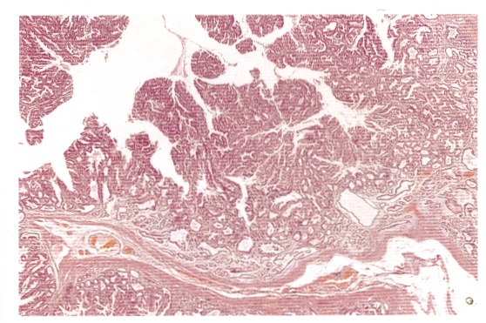
Sessile Tubulovillous adenoma

Slide 50
Tumours of the stomach
Epithelial
  Carcinoma of the stomach
  Neuroendocrine carcinoma – Carcinoid tumour
Non epithelial
  Gastrointestinal stromal tumours
  Lymphomas

Slide 51
Carcinoma of the stomach
Distribution. –
  Worldwide: Commoner in Japan, Chile, China, Portugal, Finland, Scotland.
Pathogenesis –
  Racial & Genetic factors
    Blood group A
    Blacks, American Indians, Maoris
  Envioronmental –
    Increased salt
    Complex CHO,
    Nitrites
    Low animal fat, DGLV, fruits
    Helicobacter pylori

Slide 52
Pathogenesis cont…..
3. Pathological states
  Achlohydria/ Hypochlorhydria – glandular atrophy
  Chronic gastritis A & AB
    Association with Helicobacter pylori
    Association with intestinal metaplasia
  Partial gastrectomy.

Slide 53
Pathology
Common sites –
  Pylorus & Antrum (50- 60%)
  Mainly the lesser curve (40 %)
Early gastric carcinoma –
  Mucosa & Submucosa involved.
    Protruding
    Flat
    Depressed.

Slide 54
Pathology contd….
Advanced gastric carcinoma-
  infiltrating / spreading beyond the muscularis propria.
    Ulcerative
    Ulcerated - infilterative
    Polypoidal
    Diffusely infilterative (Linitis plastica)

Slide 55
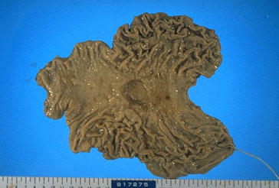
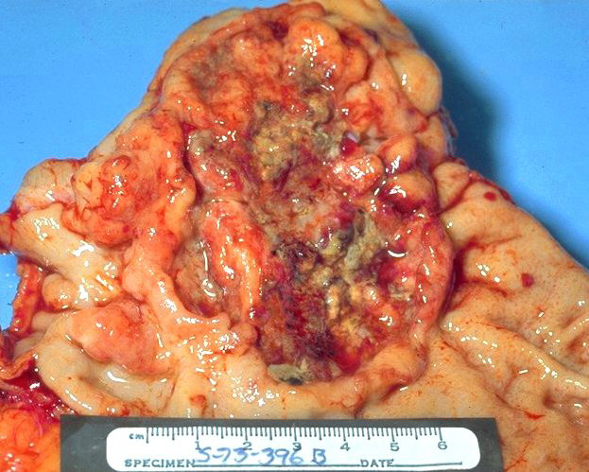
Macroscopy
Ulcerative
Ulcerative

Slide 56
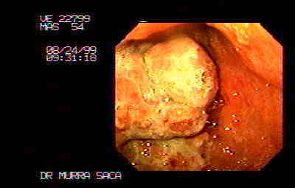
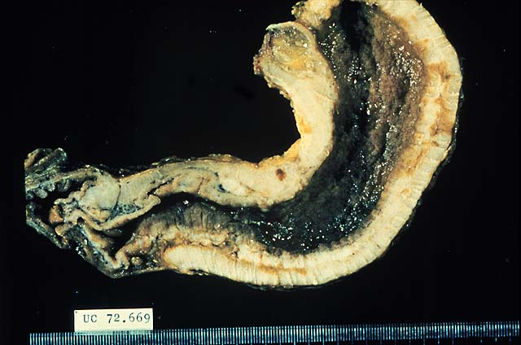
Macroscopy
Polypoidal
Linitis plastica – infiltrative

Slide 57
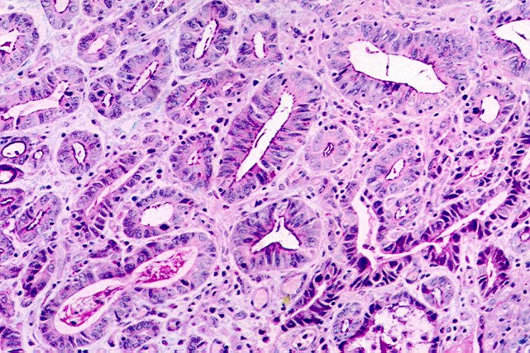
Histology
Adenocarcinoma
  Well differentiated.
  Moderately “
  Poorly “ Mucoid carcinoma with signet ring cell differentiation.
  Lauren Classification - Intestinal & Diffuse.

Slide 58
Clinical features
Tumor itself –
    Anaemia
    Anorexia,
    Asthenia
    LOW
Metastases –
    Jaundice & Hepatomegaly.
    Ascites
    Virchows node
    Umbilical nodules
    Krukenberg tumors.
    POD deposits
    Thrombophlebitis migrans.

Slide 59
Other Gastric tumours
Carcinoid tumour / Neuroendocrine tumour
Lymphoma
Gastrointestinal stromal tumour

Slide 60
Assignments
Correlate different gastric diseases with the endoscopic findings.
  Gastritis (Diffuse / pangastritis, antral predominant and corporal predominant)
  Ulcers
  Polyps
  Diffuse thickening of the stomach – Linitis plastic
  Rugal hypertrophy

Slide 61
Assignments
Helicobacter pylori
  Bacterial characteristics and pathogenic mechanisms
  Investigation methods
  Gastric pathology induced by H pylori
Identify the different clinical features and presentations of gastric carcinoma in a patient

Slide 62
Additional reading
Gastric polyps
Gastric pathology lecture - VLE

